Slide 1
Data Science
What?Why? How?
Dr. Panchatcharam M
Associate Professor, Department of Mathematics and Statistics, IIT Tirupati

Slide 2

Briyani

Slide 3


Small Video
https://youtu.be/ZWFmAsHD2qY
https://youtu.be/geEImDEDEQA

Slide 4

Hello!
I am Dr. Panchatcharam M
I am an Associate Professor at IIT Tirupati.
You can find me at panch.m@iittp.ac.in

Slide 5

References
Kenneth S B, Bruce B A, Research Design and Methods, A Process Approach, 8th Edition, McGraw Hill, 2011
Michael M, Head First Data Analysis, Oreilly, 2009
Lymann R O, Michael L, An Introduction to Statistical Methods and Data Analysis, 6th Edition, Cengage, 2010
https://www.questionpro.com/blog/data-analysis-in-research/
https://www.geckoboard.com/blog/how-to-analyze-data/
https://www.analyticsfordecisions.com/importance-of-data-analysis-in-research/
Qualitative Data Analysis Techniques
Collecting and Analyzing Data

Slide 6
Data
1
What is Data?

Slide 7
Data
Quantities
Images
Information
Numbers
Facts
Graphs
Data
Observations
Measurement

Slide 8
Data is Everywhere
Everyone deals with mountains of data – Are they Data Analyst?
Drives real-world action: How to translate raw numbers into intelligence
How to break down?
How to structure the complex problems and data sets to get right at the heart of the problems in their research?

Slide 9

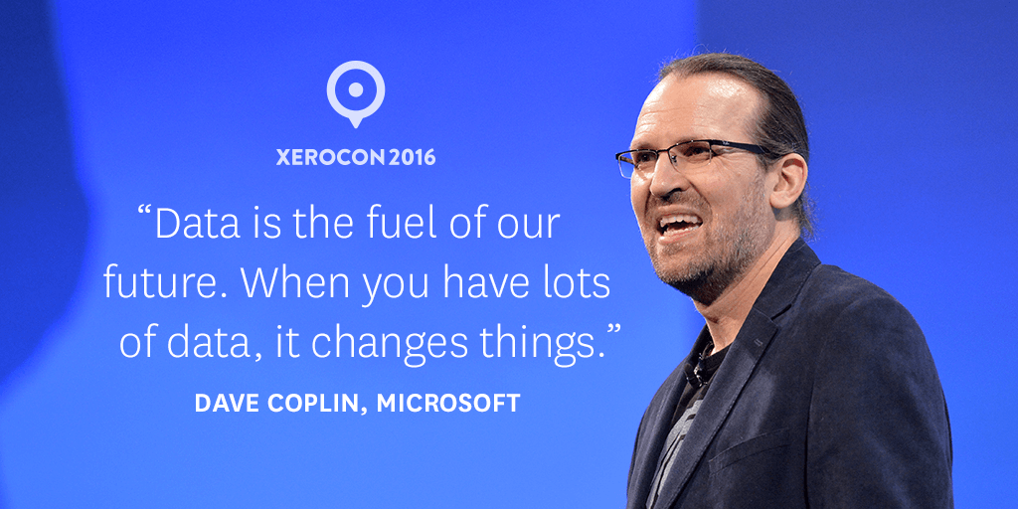
Data is the Fuel

Slide 10
Data Collection
1a

Slide 11

Data Collection
Primary Data
Secondary Data
Methods of Data Collection
Important Data Available for Scientists in Web
Public Domain Database
How to use Public Domain Database in Research

Slide 12
Data Analysts
1b
Who is Data Analyst?

Slide 13
Data Analysts
Dataset – 1
  Questions and Answers
Dataset – 2
  Questions and Answers
Dataset – 3
  Questions and Answers

Slide 14
Data Analysts
Knowing how to use excel, qualifies you as Data Analyst?
Good Data Analysts always want to see data

Slide 15
Data Analysis
2
Let’s explore what is Data Analysis

Slide 16
What does Data Analysis mean?
Refer to one method or many?
Collection of different procedure?
Without background of Mathematics and Statistics, can you learn to identify and use data analysis in your work?

Slide 17
What does Data Analysis mean?
Define
Disassemble
Decide
Evaluate
Careful thinking about evidence
Define: Know your problem
Disassemble: Break problems and data into smaller pieces
Evaluate: Draw your conclusions
Decide: Make or Recommend Decision

Slide 18
Practice of working with data to glean useful information which can be used to make informed decisions

Slide 19
Process of inspecting, rearranging, modifying and transforming data to extract useful information from it.

Slide 20
Data analysis is a messy, ambiguous, and time-consuming, but a creative and fascinating process through which a mass of collected data is being brought to order, structure and meaning.
--Marshall and Rossman

Slide 21
Data analysis and interpretation is a process representing the application of deductive and inductive logic to the research and data analysis.

Slide 22
Data Science: What?
3
What is Data Science?

Slide 23
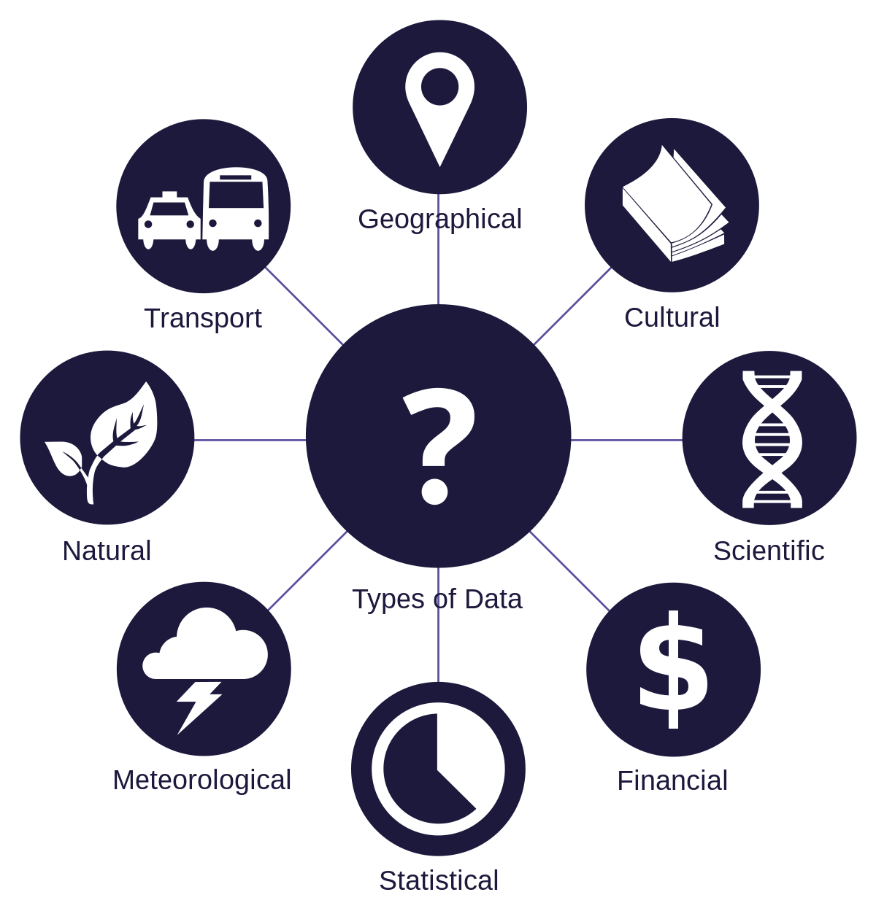
Data Science: What?
Also known as data-driven science
An interdisciplinary field of scientific methods, processes, algorithms and systems to extract knowledge of insights from data in various forms, either structured or unstructured
¹https://www.splunk.com/pdfs/dark-data/the-state-of-dark-data-report.pdf

Slide 24
Data Science: What?
Intends to analyze and understand actual phenomena with data
To reveal the features or the hidden structure of complicated natural, human and social phenomena with data from a different point of view from the established or traditional theory and method.
¹https://www.splunk.com/pdfs/dark-data/the-state-of-dark-data-report.pdf

Slide 25
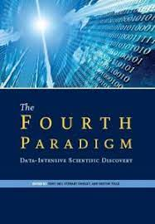
Data Science: What?
Fourth Paradigm
Changes of all sciences moving from observational to theoretical to computational and now to the 4th paradigm – Data-Intensive Scientific discovery
Observational:
  Think of Newton, Kepler, Archimedes
Theoretical:
  Riemann, Galois, Weierstrass, Einstein
Computational:
  Last 50 years of the research in the world
¹https://www.splunk.com/pdfs/dark-data/the-state-of-dark-data-report.pdf

Slide 26
Data Science and Big Data
4
Difference

Slide 27
Data Science and Big Data
Are they the same thing? No
Big Data
Crude Oil
Extracting Crude oil
Transporting it in mega tankers
Siphoning it through pipelines
Storing it in Massive Silos
Data Science:
Refining the Crude Oil
Carlos Samohano
Founder, Data Science London

Slide 28
Data Mathematics: What?
5
What is Data Mathematics?

Slide 29


Data Mathematics
Mathematical Concepts and Techniques
Mathematical concepts, techniques and tools used to analyze data
Linear Algebra
Fundamentals of Linear Algebra that deals with large amount of data
Statistics
Fundamental part of Data Mathematics
Probability Theory
To deal with uncertainty in data
Calculus
Helps in optimization problems

Slide 30
Data Mathematics: Why?
6
Why Mathematics in Data

Slide 31
Data are not facts
There is always data to support facts

Slide 32
Data Analysis: Why?
Critical for all employees
Many researchers/companies struggle with data organization and analysis
Global Survey Splunk¹: 55% of all data collected – dark data
Dark Data: Data collected but never used
Data collected, but do not know how to analyse it
¹https://www.splunk.com/pdfs/dark-data/the-state-of-dark-data-report.pdf

Slide 33
Data Analysis: Why?
76% executives¹ believe training current employees in data science will help to understand dark data
If you understand how to analyse different types of data, you can make better output
¹https://www.splunk.com/pdfs/dark-data/the-state-of-dark-data-report.pdf

Slide 34

Big concept

Slide 35
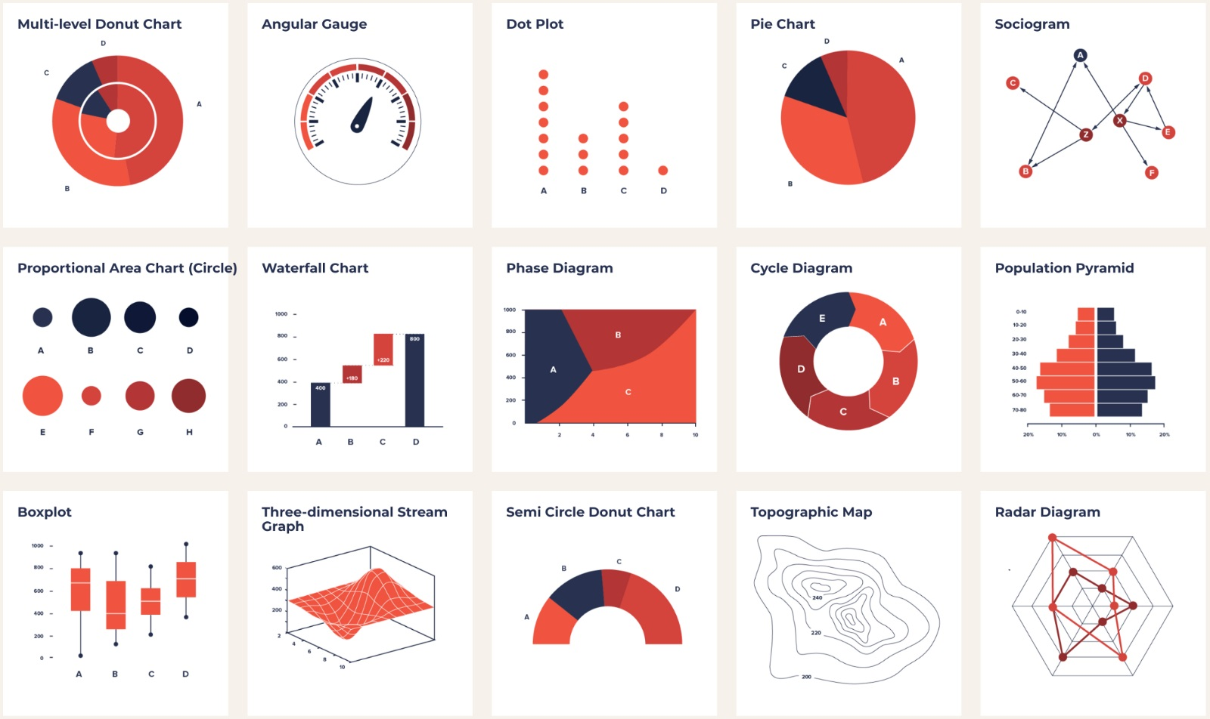
Data Mathematics: Why?
Mathematics is crucial in data-related fields for several reasons
Statistics: Statistics, a branch of mathematics, helps in drawing meaningful conclusions from data, estimating parameters, and making predictions.
Machine Learning: Algorithms used in machine learning are often based on mathematical concepts, such as linear algebra, calculus, and probability theory.

Slide 36
Data Mathematics: Why?
Optimization: Mathematical optimization techniques are used to fine-tune models and algorithms.
Data Visualization: Geometry and statistics play a role in creating effective data visualizations.

Slide 37
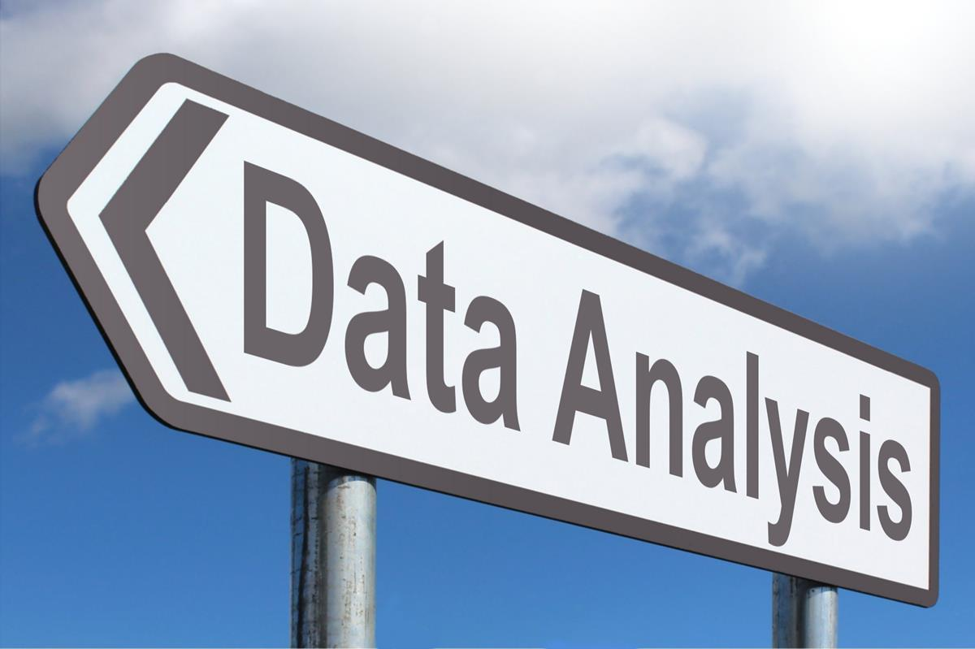
Data Mathematics: Why?
Detailed View
Data Analysis: Mathematics provides the tools to analyze and interpret data effectively. Techniques like statistical tests, regression analysis, and hypothesis testing are all based on mathematical principles

Slide 38
Data Mathematics: Why?
Detailed View
Quantification: Mathematics allows us to quantify and measure various aspects of data, such as central tendencies (mean, median), dispersion (variance, standard deviation), and correlations.
Probability and Statistics: Probability theory and statistics are the backbone of data mathematics. They help in making sense of uncertain data, drawing meaningful conclusions, and making predictions.

Slide 39

Data Mathematics: Why?
Detailed View
Quantification: Mathematics allows us to quantify and measure various aspects of data, such as central tendencies (mean, median), dispersion (variance, standard deviation), and correlations.
Probability and Statistics: Probability theory and statistics are the backbone of data mathematics. They help in making sense of uncertain data, drawing meaningful conclusions, and making predictions.

Slide 40

Data Mathematics: Why?
Detailed View
Machine Learning: Machine learning algorithms, a core component of data mathematics, often rely on linear algebra, calculus, and optimization techniques, all of which are mathematical in nature.
Data Visualization: Creating effective data visualizations requires an understanding of geometric principles and mathematical concepts to accurately represent data.

Slide 41

Data Mathematics: Why?
Detailed View
Predictive Modeling: Mathematical modeling is used to build predictive models that can forecast future trends or outcomes based on historical data.
Data Preprocessing: In data cleaning and preprocessing, mathematical techniques are used to handle missing values, outliers, and scale data appropriately.

Slide 42
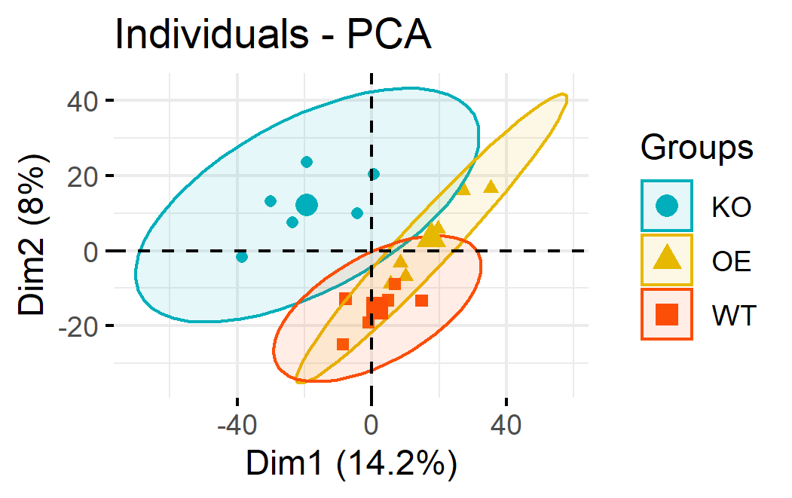
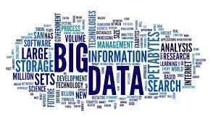
Data Mathematics: Why?
Detailed View
Dimensionality Reduction: Methods like Principal Component Analysis (PCA) use mathematical transformations to reduce the dimensionality of data while preserving its essential features.
Big Data: Dealing with large datasets and optimizing data processing often involves mathematical approaches for efficient computation and storage.

Slide 43
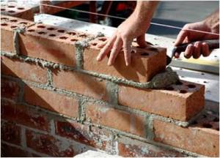
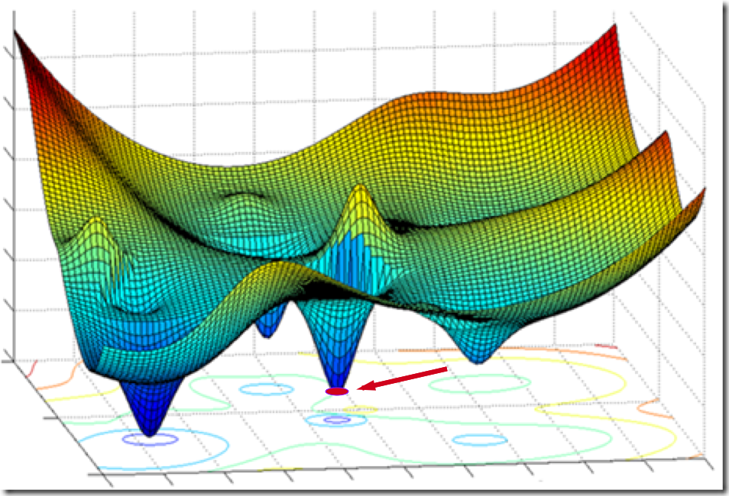
Data Mathematics: Why?
Summary
In summary, mathematics provides the foundation for understanding, processing, and extracting insights from data.
It offers the language and tools needed to tackle the challenges of working with data, making it a fundamental aspect of data mathematics.

Slide 44
Data Mathematics: How?
7

Slide 45

Data Mathematics: How?
Data Analysis: A skill you can learn
  By doing advanced statistics course
  In-depth training module to understand how to analyse data

Slide 46
Data Mathematics: How?
Define Goals
Build data analysis toolkit
Compare Current Data against historical trends
1
3
5
2
4
6
Clean Data
Look for patterns and trends in the data
Visualize data and interpret results

Slide 47


Data Mathematics: How?
Define Goals
Before starting to analyse data
  Set some clear objectives
If no idea, you will stare at spreadsheet or scrolling through dataset
Goal depends on the research, data collected and your role in research

Slide 48
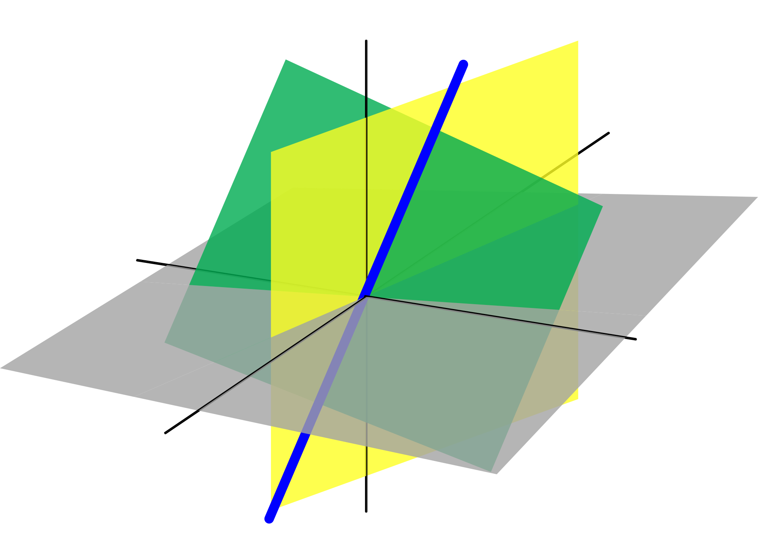
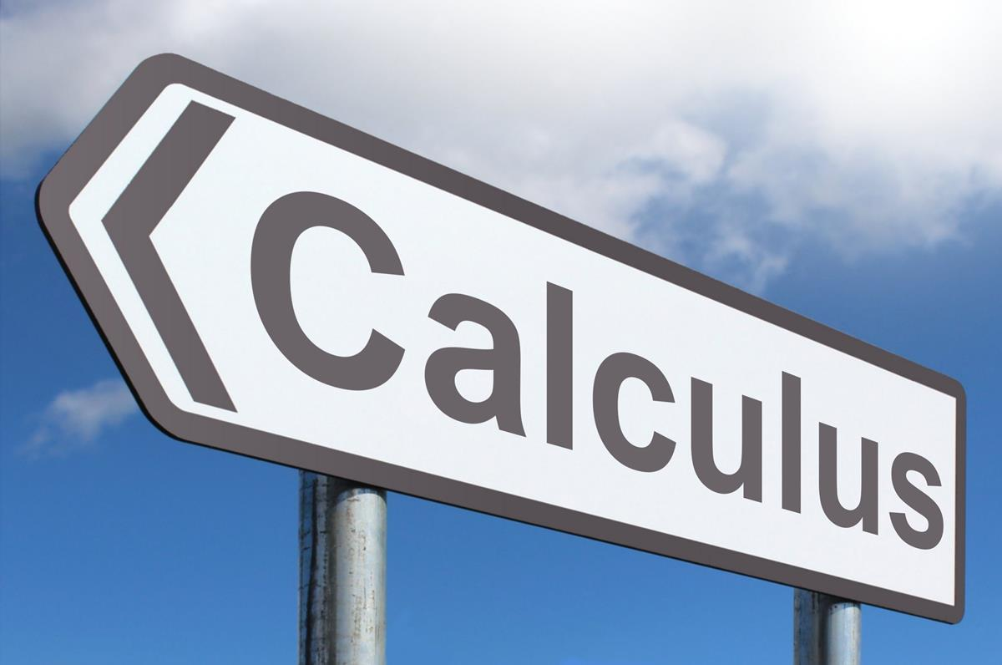
Data Mathematics: How?
Linear Algebra and Calculus
Linear Algebra: Used in dimensionality reduction, eigenvalue decomposition, and linear regression.
Calculus: Helps in optimization problems, like gradient descent in machine learning.

Slide 49
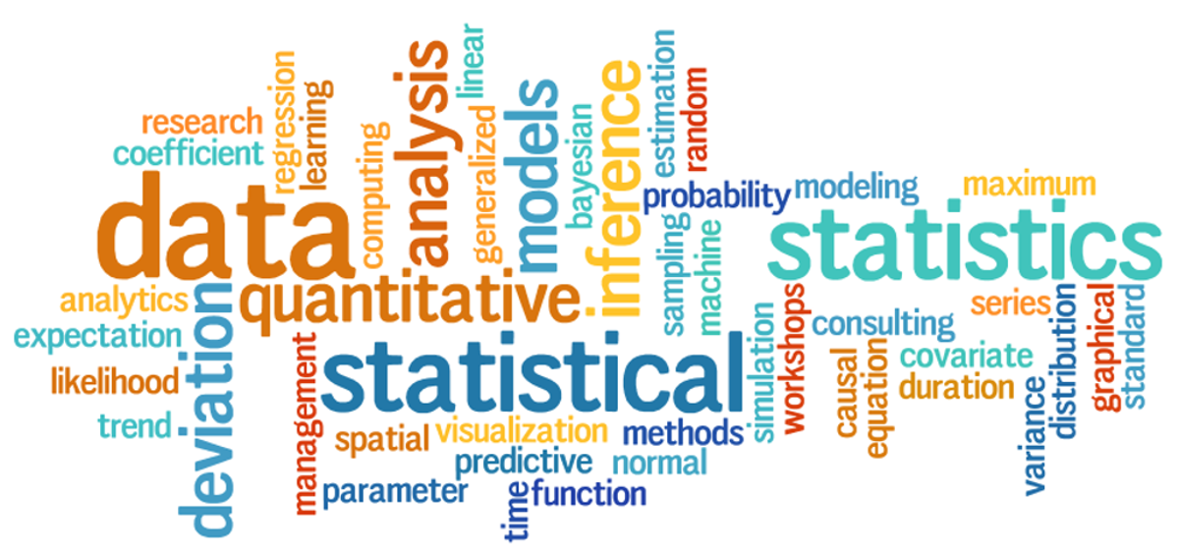
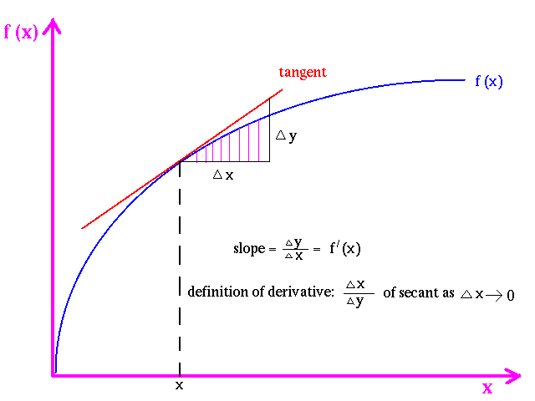
Data Mathematics: How?
Probability and Statistics, DEs
Probability and Statistics: Used for hypothesis testing, probability distributions, and sampling.
  Descriptive, Inferential, Regression, Time series analysis
Differential Equations: Applied in modeling dynamic systems, like in epidemiology or physics-based simulations.

Slide 50
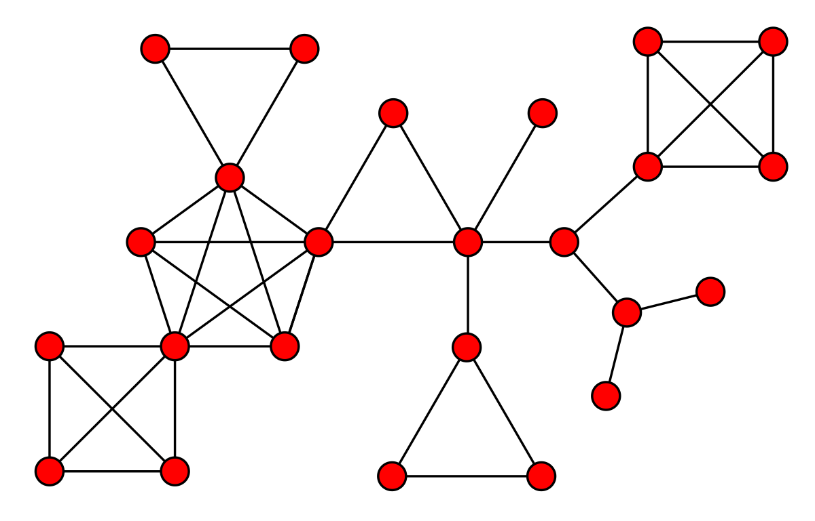
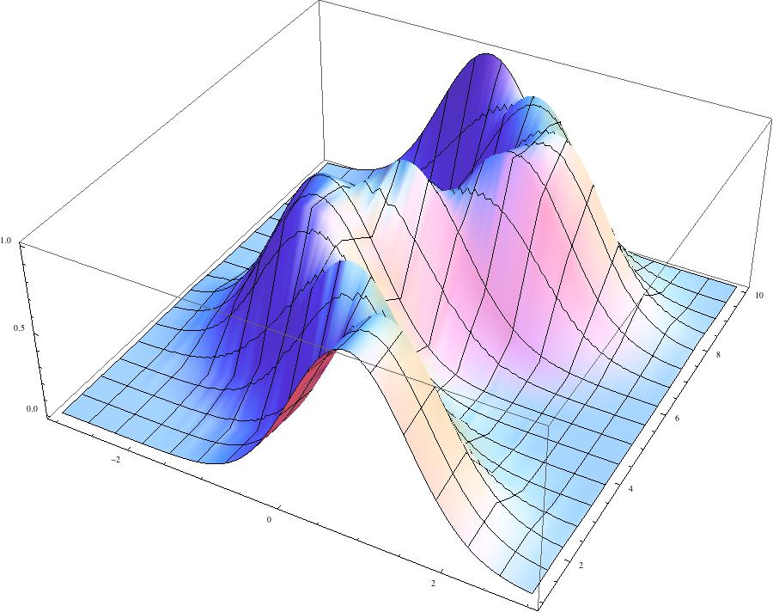
Data Mathematics: How?
Graph Theory and Numerical Analysis
Graph Theory: Useful for analyzing networks and relationships in data.
Numerical Analysis: Helps in solving complex mathematical problems efficiently.

Slide 51
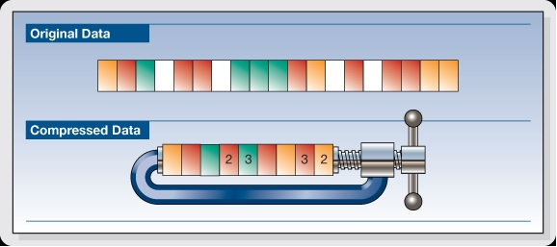

Data Mathematics: How?
Data Compression and Optimization
Data Compression: Mathematical techniques like the Huffman coding algorithm are used for data compression, reducing the storage space required.
Optimization Problems: Mathematics is used to solve optimization problems, such as finding the best route for delivery trucks or the optimal allocation of resources.

Slide 52

Thanks!
Any questions?
You can reach me at:
panch.m@iittp.ac.in

